Slide 1
National Rx Drug & Heroin Summit: Lessons Learned
Governor’s Commission on Opioids and Addiction
May 17, 2019

Slide 2
Virginia State Police Trooper Murphy

Slide 3
Themes
Increase in stimulant-related deaths
    Accidental exposure
    User behavior
    Implications for law enforcement and treatment
Need for linkages to treatment
    Population lens – ER, incarceration/re-entry, post-inpatient
    Linkages to recovery services
Stigma = discrimination

Slide 4
National Stimulant Data

Slide 12
Linkages to treatment
Priority Treatment Populations
  Pregnant and parenting women and their children
  Incarcerated and supervised individuals
  People with chronic pain (alternative treatment modalities)
Supporting providers
  Increasing waivered family med, internal med, OB/GYNs, psychiatrists, and pediatricians
Recovery linkages
  Housing supports
  Workplace supports

Slide 13
Stigma
Providers – reaching the ”undecided”
  MAT education (licensing, etc.)
  Concerns about drug-seeking
Language
  “Methadone” clinic (v any other specific care setting)
  “Addict” still being used in non-recovery settings

Slide 14
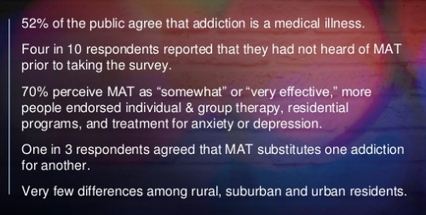
Public Survey

Slide 15
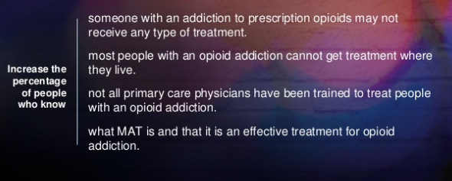
Stigma Reduction

Slide 16
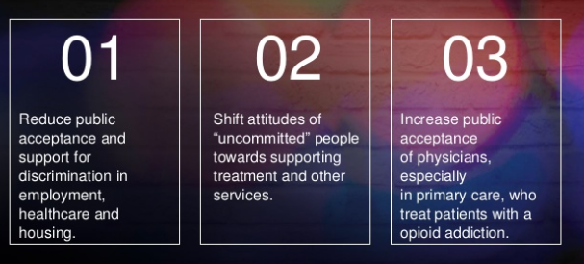
Stigma Reduction

